Slide 1
Predict Daily Active User of Boston Public Library
Using LSTM model

Slide 2
Bandung Cohort 5
Author: -Hanifan Rizki Nurahman - rightfel
-Paulus Aritonang - paulusart
-Puthut Prabancono - puthutp
Data Source: https://data.boston.gov/dataset/daily-active-user-counts

Slide 3
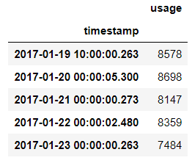

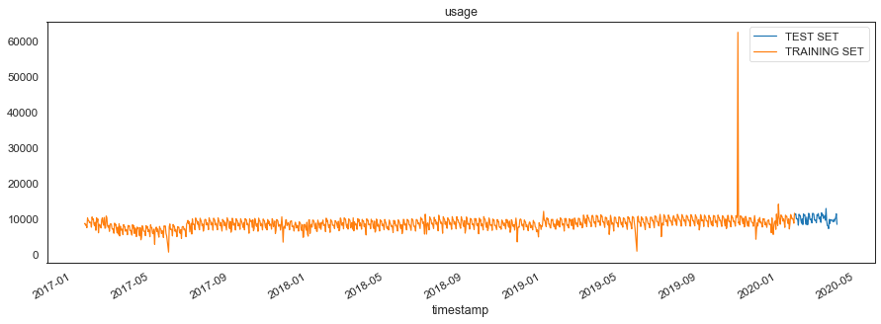
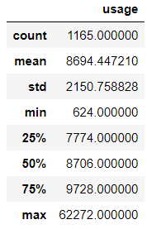
Data Summary
This data represents Boston Public Library on Mayor’s dashboard: measures how many people use the library daily based on card usage. For each card number, usage is unique on the day: multiple uses of same card on a given day are represented once

Slide 4




Framing
Framing
Labels & Feature
Goals
The data is a time-series dataset where the past value is meaningful to the future value, and because that we categorize is as a sequence type data.
This is a sequence-to- sequence models. The Labels and the feature have a same attribute in this models, which is the timestamp of the data and the sum of the library usage per-day.
Using the daily active user of Boston Library, we want to use that to predict the future using machine learning so Boston library can make a better decision for their plan.

Slide 5
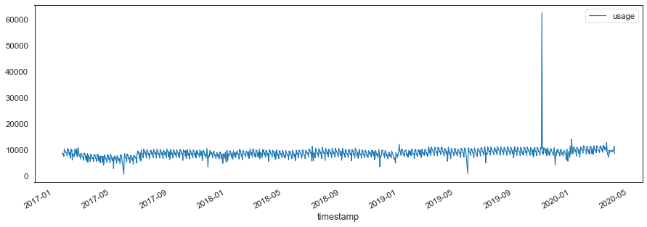
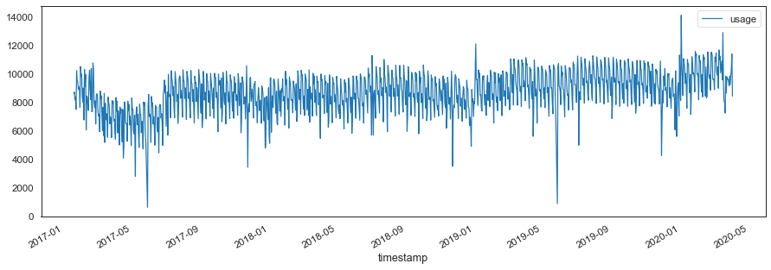
Data Preprocessing
Here on the first graph, we see that there is an anomaly, where the at around the end of 2019 there is around sixty thousand people that use the library on that day. We assume that that is an error, so we change it with the average the data. And plot the data again on the bottom graph.
Next, split the data & transform it

Slide 6
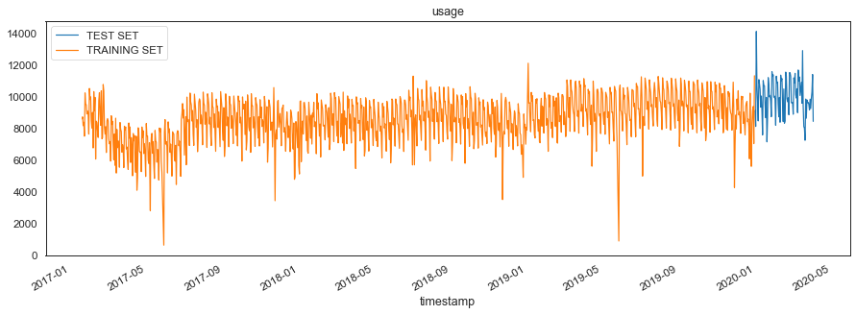
Split the Data and Transform It
When split a time-series dataset we cannot randomize it because it is a sequence data type, so we split the data for the train set is from 19 January 2017 until 31 December 2019 and the test set is from 1 January 2020 until 3 April 2020.
In a graph it will be looks like this
And before actually feed it to our models, lets transform it using MinMaxScaler

Slide 7
Long Short-Term Memory Models
Why LSTM?
Model Architecture
A benefit of this type of network is that it can learn and remember over long sequences as we have a time-series daily data with 1165 day.
This model have 128 neurons in the first hidden layer and 1 neuron in the output layer for predicting library daily usage.
Use the MSE loss function and the efficient Adam version of stochastic gradient descent.
The model will be fit for 100 training epochs with a batch size of 7.

Slide 8
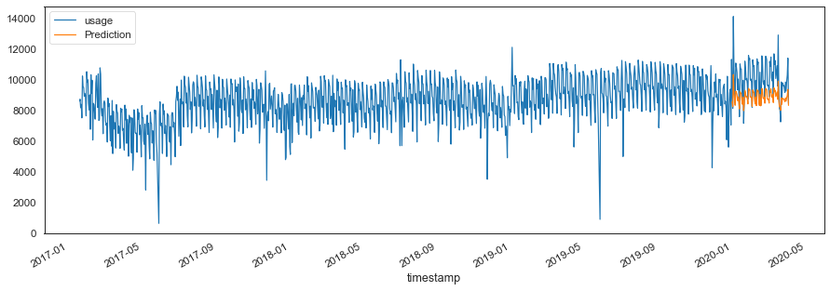
Model Prediction
In a graph it will be looks like this, the blue line is the real value and the orange one is the model prediction.

Slide 9
How Good is Our Models?
On the test set, the models get 11% error, which is still pretty good to deploy it to predict daily library usage at Boston Library.

Slide 10
Conclusion
As we look at the graph, the prediction that colored yellow is not that fit with the test set, it pretty much lower than the actual data, perhaps because the data have some outliers with a small value. but we cannot change them since it is a time-series data which mean every past value is meaningful to the future. What we can do is make the model more robust to the outliers in the future.

